Slide 1
Finding the perfect match
Young People Lifestyle Cluster and
Speed Dating Classifier
Group S
Ka Yu Lau 41895118
Jithendar Nethiram 44521987
Suchith Kumar Suresh 45502897

Slide 2
Project Background
Online Dating has became the second most preferred method for people finding a relationship
Traditional Speed Dating Event Host has faced challenges on how to improve their events in order to compete with these apps

Slide 3
Project Objective
Provide tools that allows speed dating event host organize better event by improving the chance for the participants to find a ‘match’.
This is done by grouping people into similar groups or putting similar people together or put people that are likely to find each other match together

Slide 4
Project Structure
`
Project
Young People Lifestyle Clusters
Speed Dating Classifier
Better Match Better Event!
Data source
Speed Dating Experiment - Columbia Business School
Young People Survey - Slovak University of Technology , Bratislava

Slide 5
Young People Survey – Data Set
Data source is from Slovak University of Technology , Bratislava.
All participants were of age between 15-30.
1010 data entries
Data (scale of 1-5)
Movie preferences ,Hobbies & interests, Personality traits and Spending habits.

Slide 6
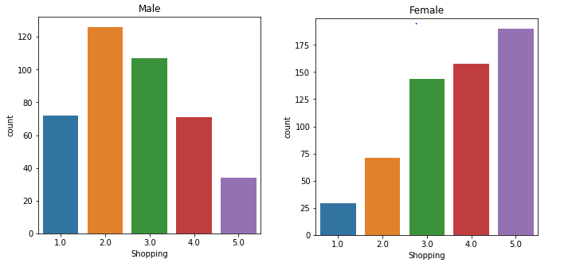
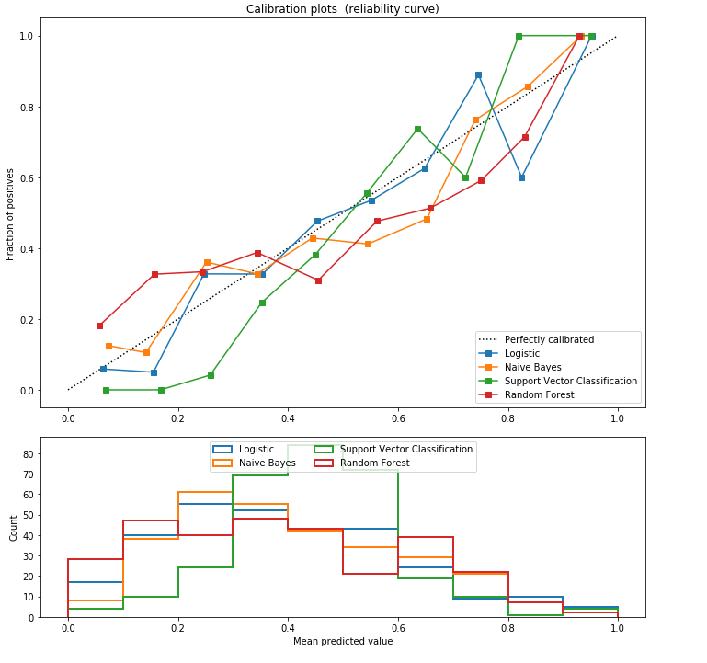
Young People Survey – Data Set

Slide 7
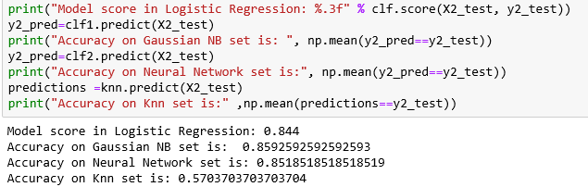
Young People Survey – Result
Clustering with similar features in the data and predicting the test accuracy

Slide 8
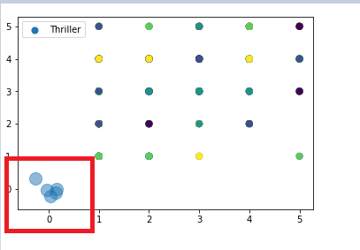
Young People Survey – Result
Clustering data using kmeans

Slide 9
Speed Dating Classifier – Data Set
Differences
Match?
Age
Income
Interest
Race
Go out frequency
Field of work/study

Slide 10
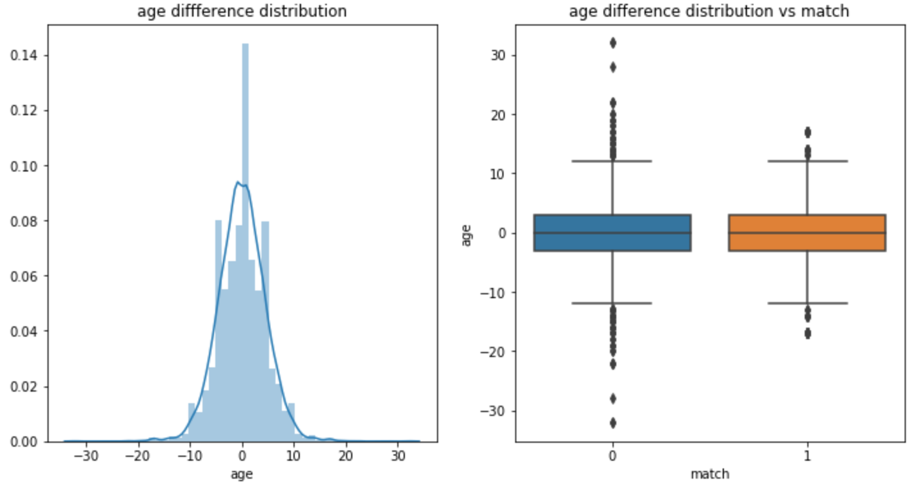
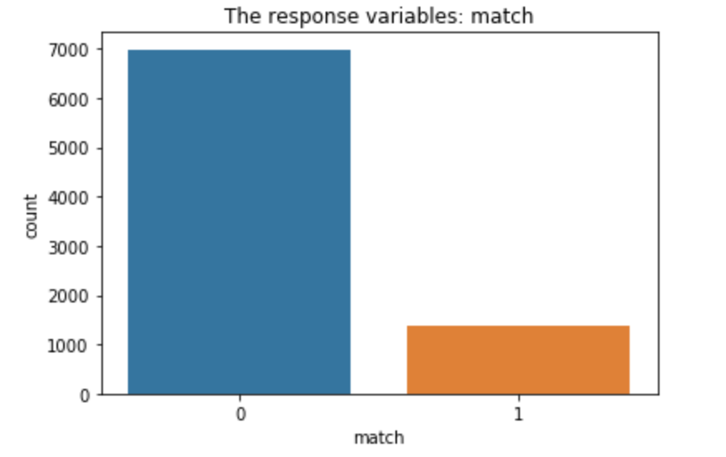
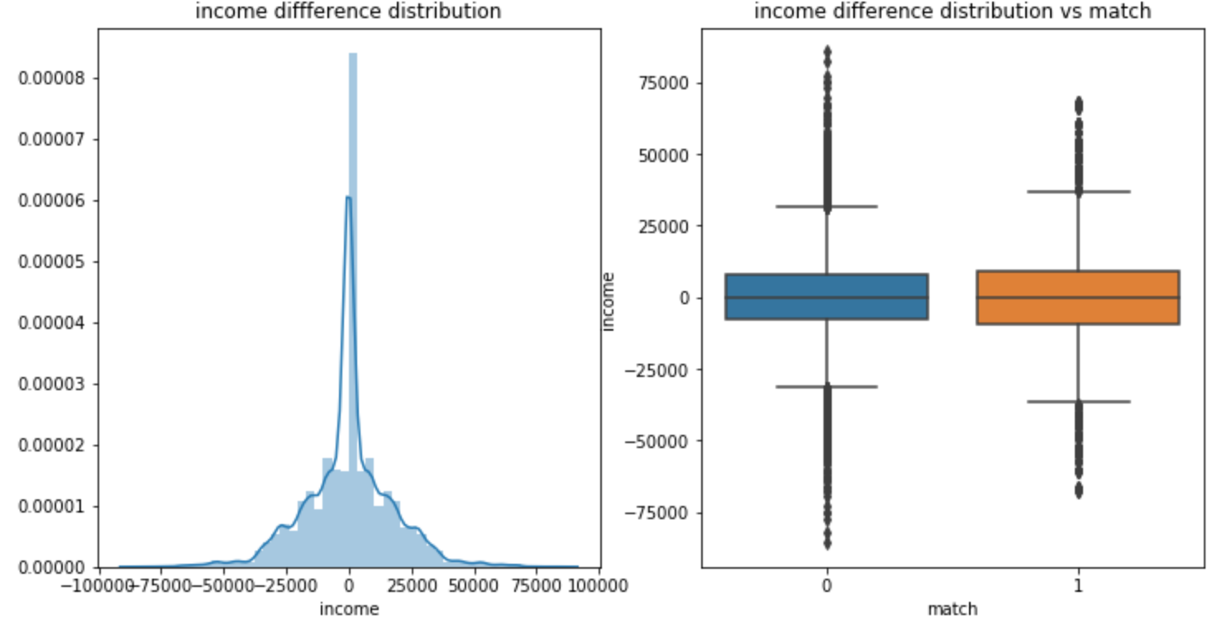
Speed Dating Classifier – Data Set

Slide 11
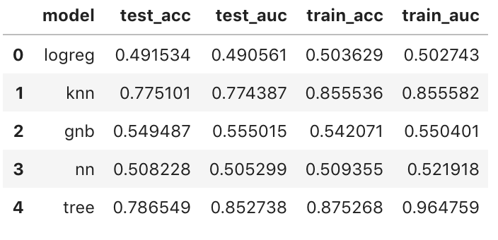
Speed Dating Classifier – Result
Feature Importance
Income > Age > interest > field > race > go_out

Slide 12
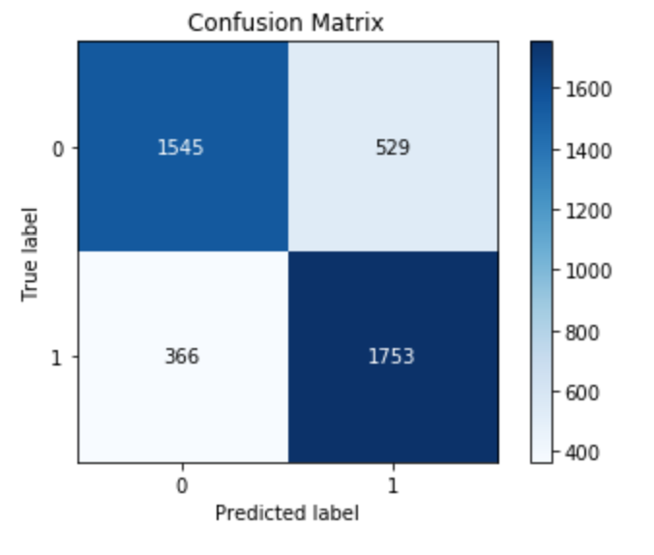
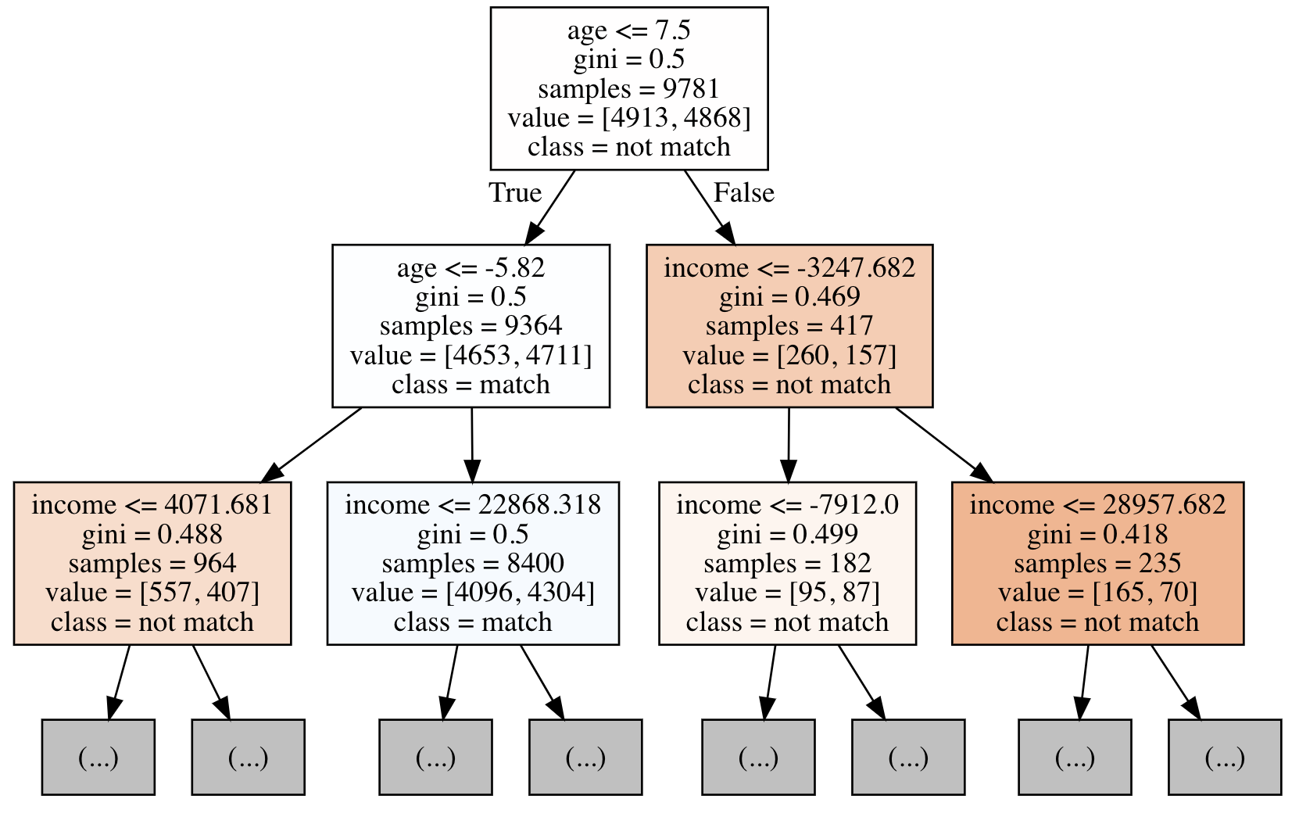
Speed Dating Classifier – Result

Slide 13
Technique used
Lifestyle Clustering
K-mean
Logistic Regression
Naïve Bayes
Neural Network
KNN
Speed Dating Classifier
Resampling
Logistic Regression
Naïve Bayes
Neural Network
KNN
Decision Tree

Slide 14
Summary
We have created two tools for speed dating event host
Lifestyle clusters which help to group people with similar interest into one event
Speed dating classifier to pair up people who are likely to match
However, the data we used to train the model are limited to certain culture and location which may need improvement if we wish to apply it to a broader population

